Slide 1

Artificial Intelligence Lecture 07: informed Search
Farhad Muhammad Riaz

Slide 2
Informed Search
Informed search algorithm contains an array of knowledge such as how far we are from the goal, path cost, how to reach to goal node, etc.
This knowledge help agents to explore less to the search space and find more efficiently the goal node

Slide 3
Informed Search
Heuristics Function
Heuristic is a function which is used in Informed Search, and it finds the most promising path.
It takes the current state of the agent as its input and produces the estimation of how close agent is from the goal.
The heuristic method, however, might not always give the best solution, but it guaranteed to find a good solution in reasonable time.
Heuristic function estimates how close a state is to the goal. It is represented by h(n), and it calculates the cost of an optimal path between the pair of states.
The value of the heuristic function is always positive.
h(n) <= h*(n)

Slide 4
Informed Search
Best First Search Algorithm(Greedy search)
A* Search Algorithm

Slide 5
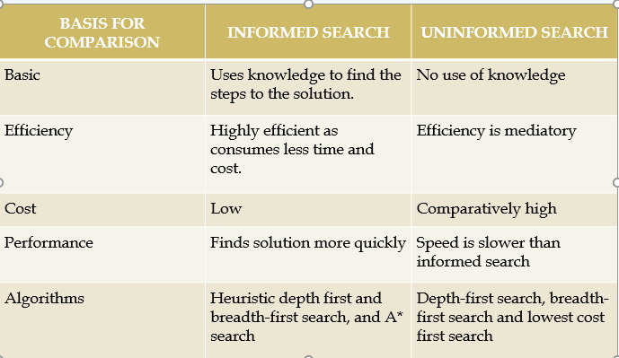
Informed Search VS unInformed Search

Slide 6
Best-First Search
Idea: use an evaluation function for each node
Estimate of desirability
Expand most desirable unexpanded node
Implementation:
fringe is a queue sorted in decreasing order of desirability
Special cases:
Uniform Cost Search (uninformed)
Greedy (best-first) Search (informed)
A* Search (informed)

Slide 7
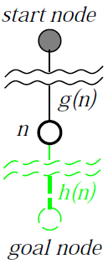
Evaluation Function
Evaluation function f(n) = g(n) + h(n)
g(n) = exact cost so far to reach n
h(n) = estimated cost to goal from n
f(n) = estimated total cost of cheapest path through n to goal
Special cases:
Uniform Cost Search: f(n) = g(n)
Greedy (best-first) Search: f(n) = h(n)
A* Search: f(n) = g(n) + h(n)

Slide 8
Greedy Best-First Search
Evaluation function h(n) (heuristic)
Estimated cost of the cheapest path from n to a goal node
E.g., h_{SLD}(n) = straight-line distance from n to Bucharest
Greedy search expands the node that appears to be closest to goal.

Slide 9
Greedy Best-First Search
Step 1: Place the starting node into the OPEN list.
Step 2: If the OPEN list is empty, Stop and return failure.
Step 3: Remove the node n, from the OPEN list which has the lowest value of h(n), and places it in the CLOSED list.
Step 4: Expand the node n, and generate the successors of node n.
Step 5: Check each successor of node n, and find whether any node is a goal node or not. If any successor node is goal node, then return success and terminate the search, else proceed to Step 6.
Step 6: For each successor node, algorithm checks for evaluation function f(n), and then check if the node has been in either OPEN or CLOSED list. If the node has not been in both list, then add it to the OPEN list.
Step 7: Return to Step 2.

Slide 10
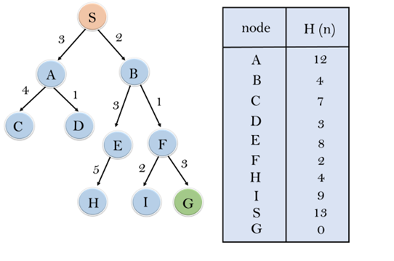
Greedy Best-First Search (Example)

Slide 11
Properties of Greedy Best-First search
Complete? No – can get stuck in loops, e.g., with Oradea as goal and start from Iasi:
Complete in finite space with repeated state checking
Time? O(b^{m}), but a good heuristic can give dramatic improvement
Space? O(b^{m}) -- keeps all nodes in memory
Optimal? No.

Slide 12
A* Search
Idea: Avoid expanding paths that are already expensive
Evaluation function f(n) = g(n) + h(n)
g(n) = exact cost so far to reach n
h(n) = estimated cost to goal from n
f(n) = estimated total cost of cheapest path through n to goal
A* search uses an admissible heuristic:
h(n) ≤ h*(n) where h*(n) is the true cost from n
Also h(n) ≥ 0, and h(G)=0 for any goal G
E.g., h_{SLD}(n) is an admissible heuristic because it doesn’t overestimate the actual road distance

Slide 13
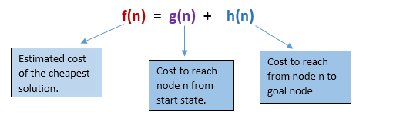
A* Search
If we are trying to find the cheapest solution, a reasonable thing to try first is the node with the lowest value of g(n) + h(n)
This strategy is more than just reasonable
Provided that h(n) satisfies certain conditions, A* using TREE search is both complete and optimal.

Slide 14
A* Search Algorithm
Step1: Place the starting node in the OPEN list.
Step 2: Check if the OPEN list is empty or not, if the list is empty then return failure and stops.
Step 3: Select the node from the OPEN list which has the smallest value of evaluation function (g+h), if node n is goal node then return success and stop, otherwise
Step 4: Expand node n and generate all of its successors, and put n into the closed list. For each successor n', check whether n' is already in the OPEN or CLOSED list, if not then compute evaluation function for n' and place into Open list.
Step 5: Else if node n' is already in OPEN and CLOSED, then it should be attached to the back pointer which reflects the lowest g(n') value.
Step 6: Return to Step 2.

Slide 15
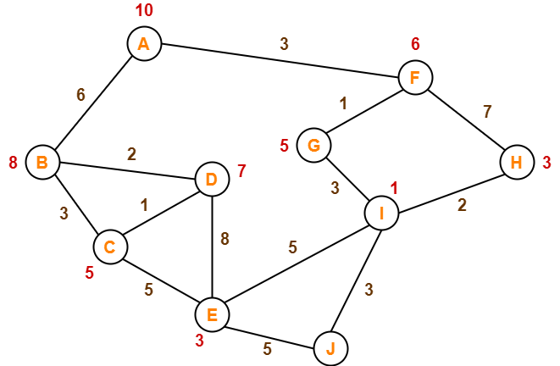
Example

Slide 16
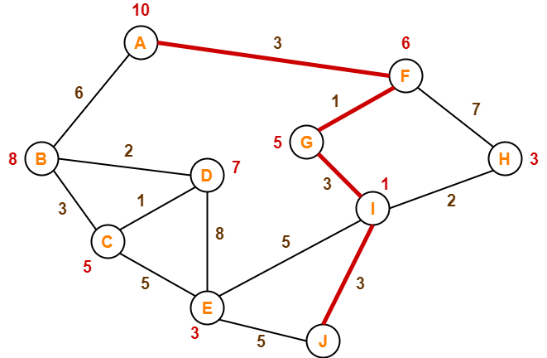
Example

Slide 17
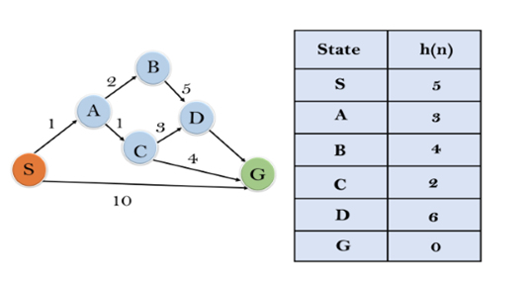
Example

Slide 18
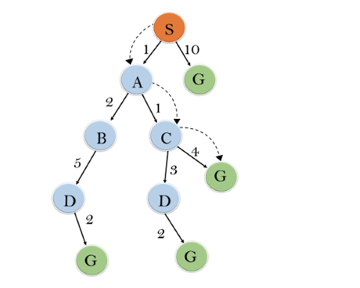
Example

Slide 19
Properties of A*
Complete? Yes (unless there are infinitely many nodes with f ≤ f(G) )
Time? Exponential
Space? Keeps all nodes in memory
Optimal? Yes

